Slide 1
NETWORKING
Types of networks
Components of a network
Seven layers of the OSI model.

Slide 2
The Challenges
We are suppose to
represent all types of information as bits.
move the bits
In large quantities,
everywhere,
cheaply,
Securely,
with quality of service,
….

Slide 3
Today’s Networks are complex!
Node or host refers to any device on a network
routers
links of various media
applications
protocols
hardware, software
Tomorrow’s will be even more!

Slide 4
Computer network A collection of computing devices that are connected in various ways in order to communicate and share resources.
A computer network consists of two or more computers that are linked in order to share resources, exchange files or allow electronic communications to take place.
The computers on a network may be linked through cables however, some connections are wireless, using radio waves, satellites, fibre optics or infrared signals.

Slide 5
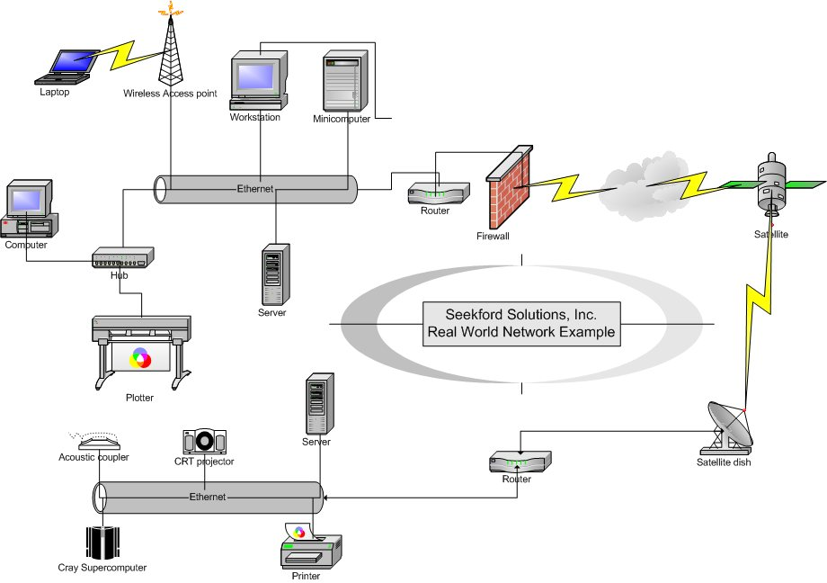

Slide 6
The three basic types of network include:
Local Area Network (LAN)
Metropolitan Area Network (MAN)
Wide Area Network (WAN)

Slide 7
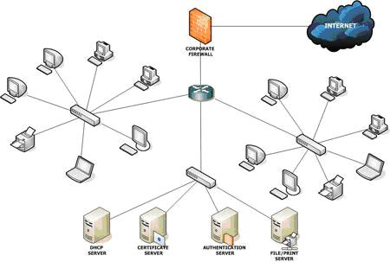
Local Area Network
Local-area network (LAN) is a type of network that connects a relatively small number of machines in a relatively close geographical area.

Slide 8
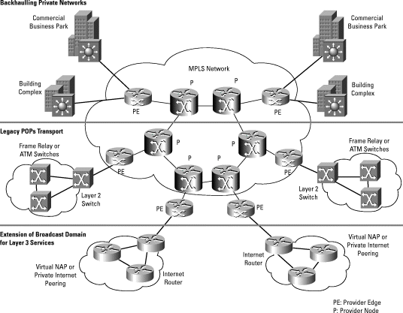
METROPOLITAN AREA NETWORK
These are the communication infrastructures that have been developed in and around large cities.

Slide 9
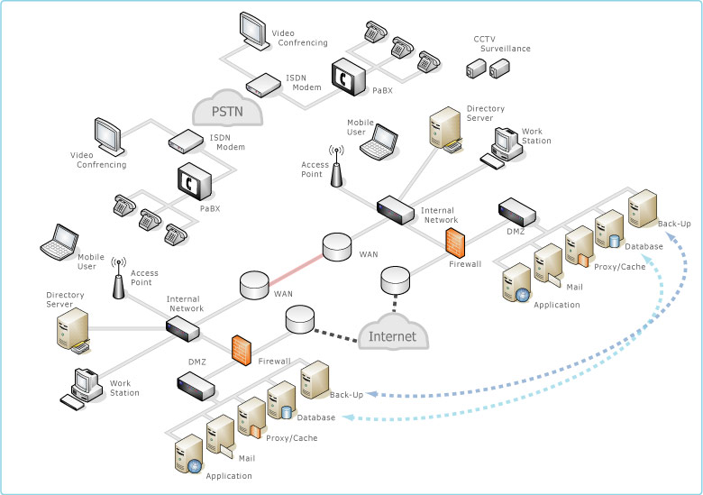
WIDE AREA NETWORK
Is a network that connects two or more LANs over a potentially large geographic distance.
Often one particular node on a LAN is set up to serve as a gateway to handle all communication going between that LAN and other networks
The Internet, as we know it today, is essentially the ultimate wide-area network, spanning the entire globe

Slide 10
Advantages of Networking
Speed
Cost
Security
Centralized software management
Resource sharing
Electronic Mail
Flexible access
Workgroup computing - Workgroup software (such as Microsoft BackOffice) allows many users to work on a document or project concurrently.

Slide 11
PROTOCOLS
A protocol is a set of rules that governs the communications between computers on a network.
Protocols regulate the following characteristics of a network:
Access method
Physical topologies
Types of cabling
Speed of data transfer.

Slide 12
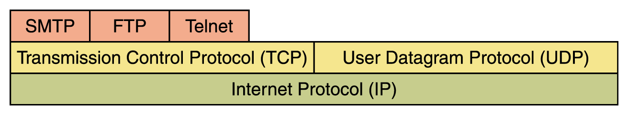
Network protocols are layered such that each one relies on the protocols that is underneath it
Sometimes referred to as a protocol stack

Slide 13
TCP stands for Transmission Control Protocol
TCP software breaks messages into packets, hands them off to the IP software for delivery, and then orders and reassembles the packets at their destination.
IP stands for Internet Protocol
IP software deals with the routing of packets through the maze of interconnected networks to their final destination.
UDP stands for User Datagram Protocol
It is an alternative to TCP
The main difference is that TCP is highly reliable, at the cost of decreased performance, while UDP is less reliable, but generally faster.

Slide 14
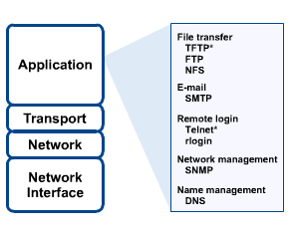
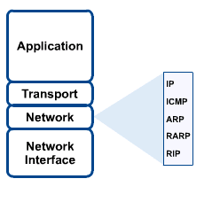
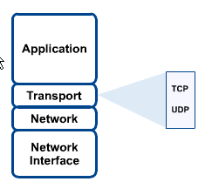

Slide 15
Some of the common protocols specified by the TCP/IP reference model layers. Some of the most commonly used application layer protocols include the following:
File Transfer Protocol (FTP)
Hypertext Transfer Protocol (HTTP)
Simple Mail Transfer Protocol (SMTP)
Domain Name System (DNS)
Trivial File Transfer Protocol (TFTP)

Slide 16
OSI Model
The open system Interconnection (OSI) is an international standard that defines information exchange between the computers and other devices on the network.
OSI is a seven layer communication protocol stack.
Each layer performs a specific function and then pass on the data to another layer.

Slide 17
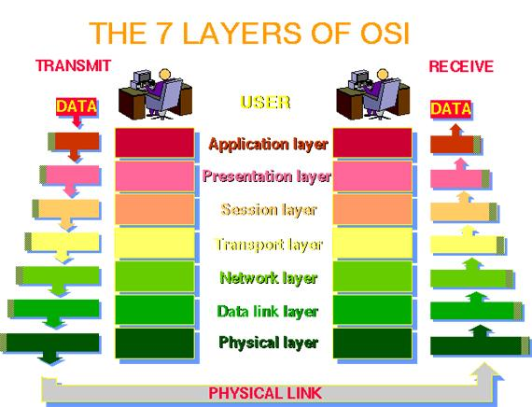
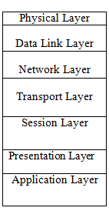
The seven layer OSI reference model
NB
It is easy to recollect the OSI layers with the acronym:
All people seem to need data processing

Slide 18
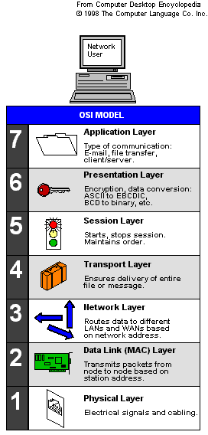

Slide 19
Physical Layer
The physical layer (layer 1) governs the physical connections between computers on a network. It defines:
Type of signaling method such as digital or analog.
The electrical and optical characteristics of the transmission signal.
Transmission characteristics such as half duplex or full duplex.
Data rate (bandwidth) such as 10 Mbps, 100 Mbps, or 1,000 Mbps.
Network layout (topology) such as star, bus, ring, etc.

Slide 20
Data Link Layer
The data link layer (layer 2), prepares data for
the physical layer .
The data link layer is also responsible for:
Organizing data bits into frames.
Address information known as MAC addressing
Error correction and retransmission.
How the data bits access a transmission medium.

Slide 21
Network Layer
The Network layer is responsible for routing, switching, and controlling the flow of data between nodes.
Services provided by the network layer include:
Adding network and node addressing information to a series of data packets prior to handing off the packet of information to the data link layer.
Support services to the transport layer and data preparation for the data link layer.
Route discovery and determination of the best route for data between two separate network locations.

Slide 22
Transport Layer
The Transport layer converts messages into segments and also breaks large segments into smaller segments that can be handled by lower layers.
It provides error checking to guarantee error free data delivery.
It provides acknowledgment of successful transmissions and requests retransmission if some packets gets damaged or corrupted.

Slide 23
Session Layer
Session layer establishes, manages, and synchronizes the communication between two nodes.
Two nodes can exchange information only after a session has been established between them.
A session is a logical connection between the two nodes.
The Session layer can also control the direction in which the data flows.

Slide 24
Presentation Layer
The Presentation layer is responsible for encoding and decoding data in a mutually agreeable format.
It encrypts the data, which enables security.
It compresses the data, which enables to reduce the size of the data packet.

Slide 25
Application Layer
The Application layer provides the interface between the end user and the network.
The processes or applications of this layer generate the data packets to be delivered.
Common applications and protocols that operate on this layer include e‑mail, FTP, and Telnet (teletype network).

Slide 26
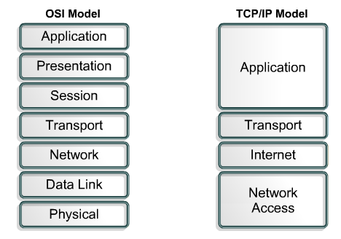

Slide 27
ETHERNET
The Ethernet protocol is by far the most widely used.
Ethernet uses an access method called Carrier Sense Multiple Access /Collision Detection (CSMA/CD).
Each computer listens to the cable before sending anything through the network.
TCP/IP protocols are the standards around which the Internet developed.

Slide 28
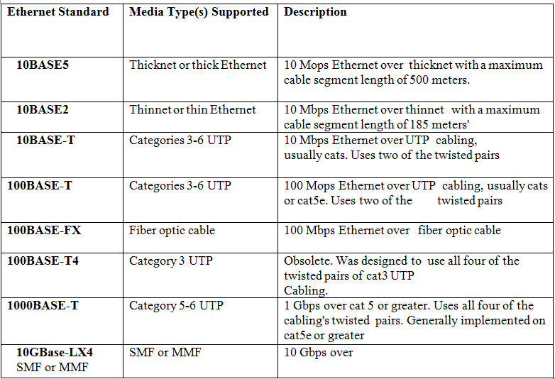

Slide 29
Networking Hardware
This includes all the computers, NICs and other equipment needed to perform data processing and communication within the network.
Basic components of a Network
Two or more PCs
Additional resources (printers, scanners etc)
Transmission medium: cables, fibre optic, wireless
Network interface cards (NICs)
Wiring Concentrator: hubs/repeaters, bridges, switch, router etc

Slide 30
NETWORK INTERFACE CARD (NICs)
NICs translate data from your computer to a format that is acceptable to the transmission medium of the LAN and vice versa.
NICs build frames, which are manageable data chunks that the LAN medium can accommodate.
NICs function at the data link layer of the OSI model.
Their installation in a computer provides the computer with a unique data link layer address known as a MAC address.
Examples include Ethernet cards, local talk connectors and token ring cards

Slide 31
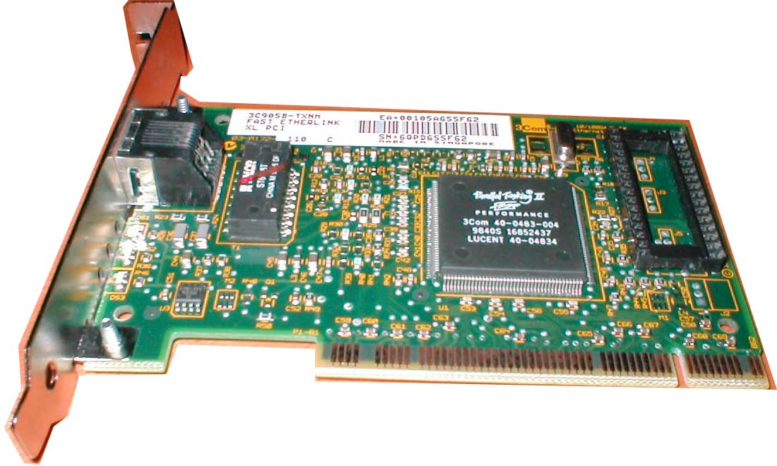
NIC

Slide 32
Network interface cards have a unique, 48‑bit address known as a media access control (MAC) address.
A Media Access Control address (MAC address) is a unique identifier assigned to most network interface cards (NICs) by the manufacturer for identification.
The address is represented as a series of six, eight bit fields such as af:00:ce:3a:8b:Oc.

Slide 33
REPEATERS
Network engineers implement repeaters to overcome signal attenuation(lost of signal strength) over long cable segments.
Repeaters are an OSI physical layer device and their functionality can be built into hubs or switches.
Repeater electrically amplifies the signal it receives.

Slide 34
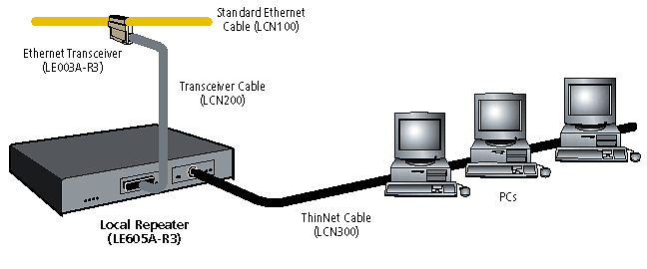
Repeater

Slide 35
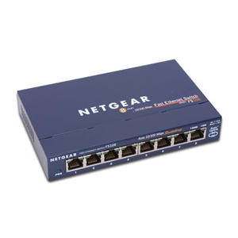
HUBS
Hubs are OSI layer 1 hardware devices that act as a connection point for servers, workstations, printers, and other computing devices.
Various types of hub technologies exist including stand‑alone hubs, stackable hubs, enterprise hubs, and network managed hubs.

Slide 36
Bridges
Bridges connect two or more LAN segments.
Bridges are OSI layer 2 devices that use MAC addresses to direct and filter traffic between LAN segments.
A bridge monitors the information traffic on both sides of the network so that it can pass packets of information to the correct location.

Slide 37
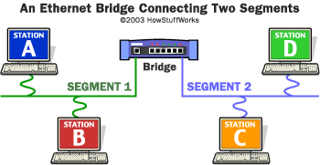

Slide 38
SWITCHES
Switches are OSI layer 2 devices that evolved from bridge technology.
Switches can read frames from multiple ports and create simultaneous forwarding paths.
Both switches and bridges have the following in common:
Both switches and bridges build MAC address tables.
Both perform frame flooding
Forwarding
Filtering

Slide 39
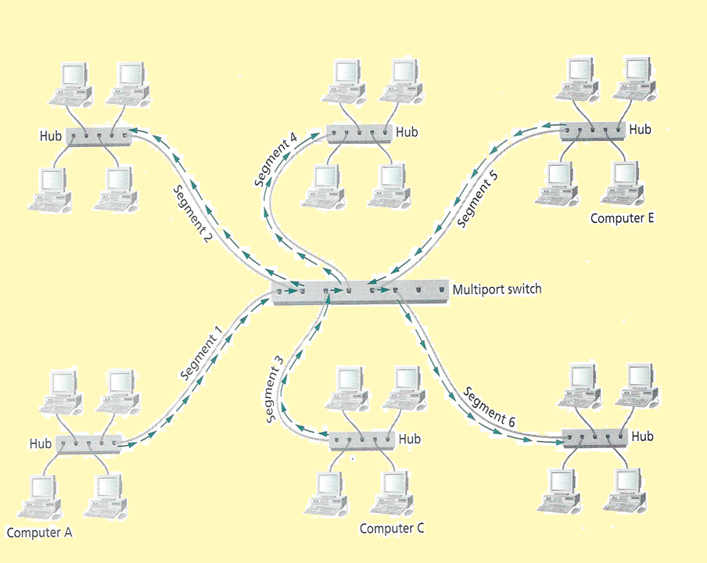

Slide 40
Differences between switches and bridges
Bridges are typically connected to hubs or other bridges but switch ports can be directly connected to individual PCs and servers or to hubs, bridges, other switches, and routers.
Bridges can process and forwarding one frame at a time. Switches can read and forward multiple frames simultaneously.

Slide 41
ROUTERS
Routers are OSI layer 3 devices.
A router connects two or more networks, with separates broadcast domains.
Directs data packets to their destinations based on IP addresses and across the best possible route.

Slide 42
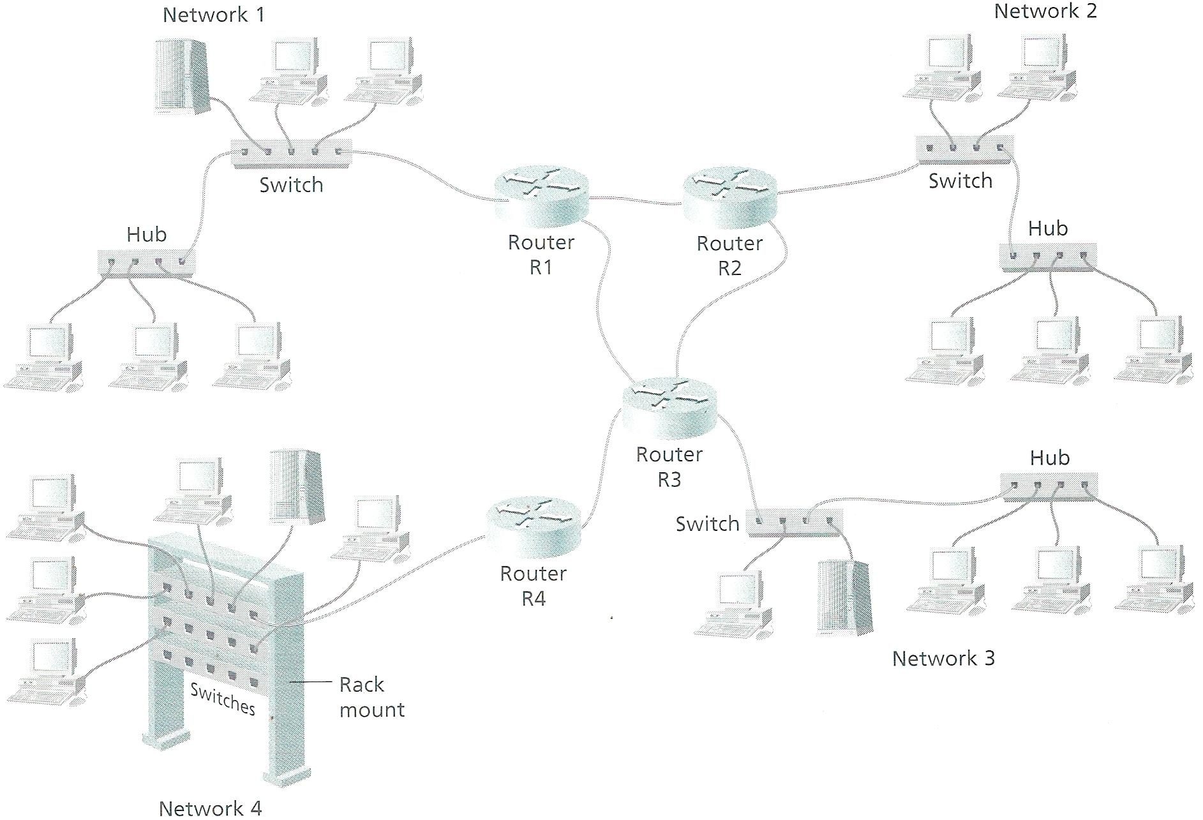

Slide 43
Routers are implemented for the following reasons:
To establish a path over which computers on one network can communicate.
Determine the best path for transmission of packets.
Improve the security of a LAN.
Provide scalability for growing networks.
To connect the LAN to distant networks.

Slide 44
GATEWAY
A gateway is hardware or software or a combination of both that provides protocol translation or connectivity between different systems.
Gateways provide connectivity between different network environments and operate at OSI layer 3 and above.

Slide 45
Gateways perform functions such as service:
connectivity between separate systems
conversion of frame sizes between different networks
protocol translation
data format conversion
A common implementation of a gateway is between a LAN and a legacy mainframe network

Slide 46
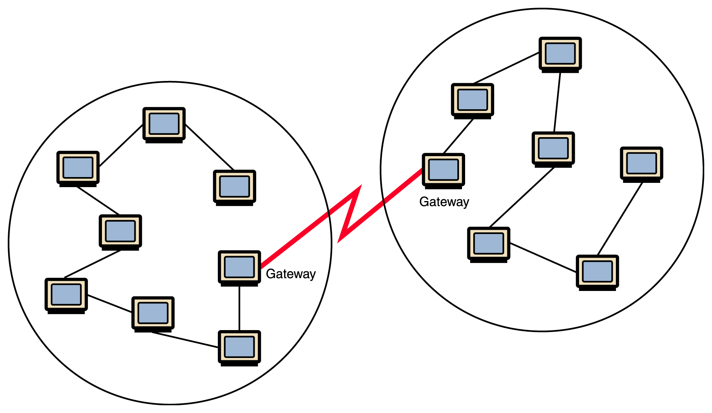

Slide 47
Some of the other types of gateways you might come across include:
E‑mail gateways: Provide the necessary e‑mail service translations between local area network e‑mail systems and external e‑mail providers.
Internet gateways: Provide internal networks that don't use TCP/IP with the protocol translation required to access an IP network or the Internet

Slide 48
Firewall Is a machine and its software that serve as a special gateway to a network, protecting it from inappropriate access.
Filters the network traffic that comes in, checking the validity of the messages as much as possible and perhaps denying some messages altogether.
Enforces an organization’s access control policy

Slide 49
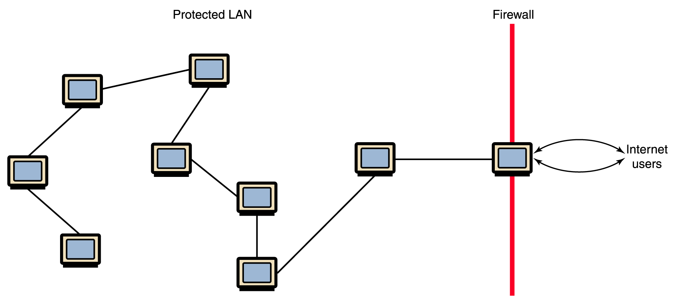

Slide 50
NETWORK CABLES
Types of cables used in networks include:
Unshielded twisted pair (UTP) cable
Shielded Twisted pair (STP) cable
Coaxial cable
Fibre Optic cable
Wireless LANs

Slide 51
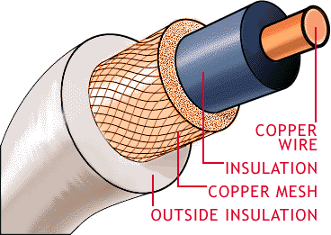
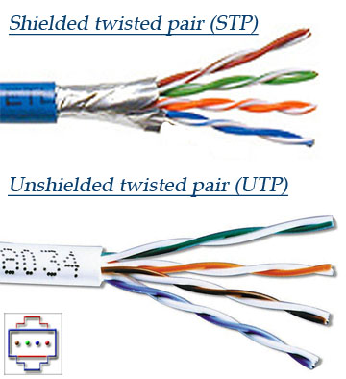
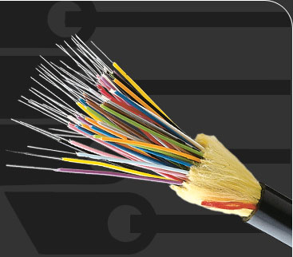
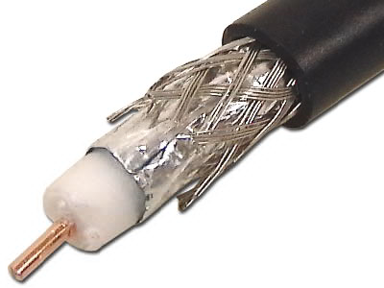
NETWORK CABLES
COAXIAL CABLE
FIBER OPTIC CABLE

Slide 52
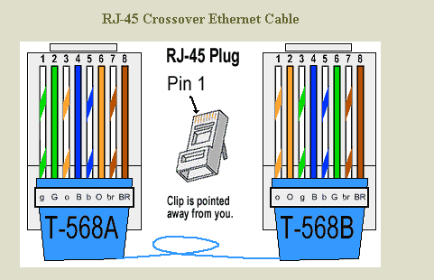

Slide 53
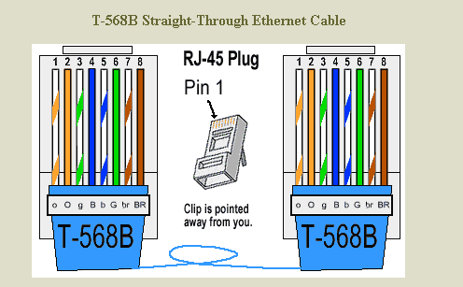

Slide 54
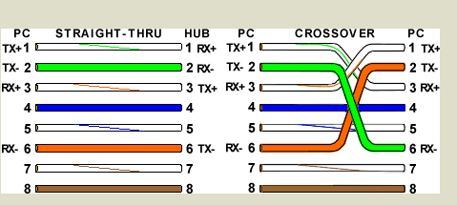

Slide 55
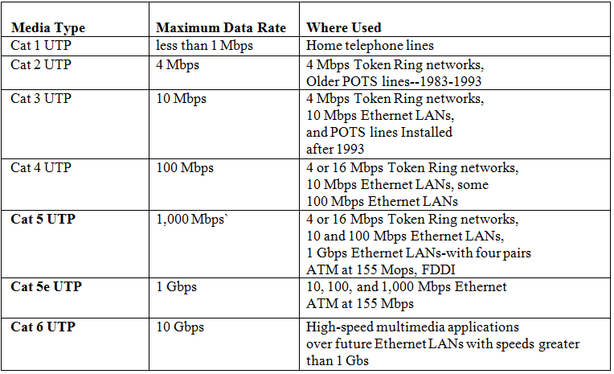

Slide 56
NETWORK TOPOLOGY
Topology is the map or layout of a network.
The two main topologies are:
Physical topology: defines the actual structure or configuration of the cables, computers and other peripherals that you can see or touch.
Logical topology: defines the conceptual network layout, which can be taught as the way that data travels or flows across the network.

Slide 57
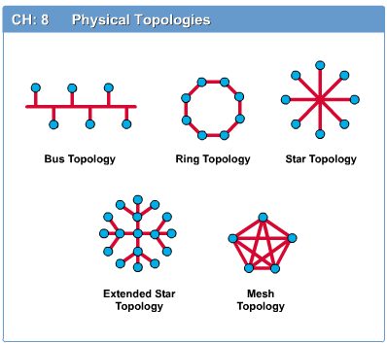
Main types of Physical topologies
Linear bus
Star
Star-wired ring
Tree
Mesh

Slide 58
All nodes are connected to a single communication line that carries messages in both directions

Slide 59
This is a configuration that centres around one node to which all others are connected and through which all messages are sent.

Slide 60
Advantages Star-star topology:
Device connectivity to the LAN can be achieved through a centralized device.
If any single cable segment fails in a star topology, the network continues to function.
Disadvantages:
Data transmission across the network will cease, if the centralized hub or switch fails.
It requires significant amounts of cable, since cables are to be run to each computing device on the LAN.

Slide 61
Ring topology A configuration that connects all
nodes in a closed loop on which messages travel in one direction

Slide 62
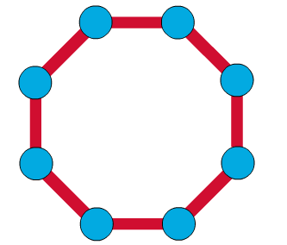
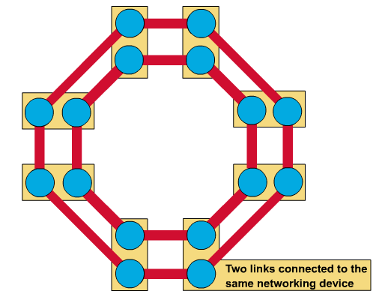
A frame travels around the ring, stopping at each node. If a node wants to transmit data, it adds the data as well as the destination address to the frame.
The frame then continues around the ring until it finds the destination node, which takes the data out of the frame.
Single ring – All the devices on the network share a single cable
Dual ring – The dual ring topology allows data to be sent in both directions.

Slide 63
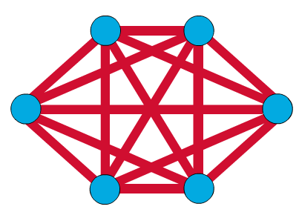
Mesh Topology
The mesh topology connects all devices (nodes) to each other for redundancy and fault tolerance.
It is used in WANs to interconnect LANs and for mission critical networks like those used by banks and financial institutions.
Implementing the mesh topology is expensive and difficult.

Slide 65
PHYSICAL TOPOLOGIES CHART
Physical Topology | Common Cable | Common Protocol
Linear Bus | Twisted Pair Coaxial Fiber Optic | Ethernet Local Talk
Star | Twisted Pair Fiber Optic | Ethernet Local Talk
Star-Wired ring | Twisted Pair | Token ring
Tree | Twisted Pair Coaxial Fiber Optic | Ethernet

Slide 66
LAN CONFIGURATIONS
Peer-to-peer
In a peer‑to‑peer LAN, each computer acts as both a client and a server. When a computer requests a service, it's acting as a client. When a computer provides services, it's acting as a server.
Client dominant
With client-dominant LANs, most of the application processing and data manipulation is performed at the client, and the server stores files.

Slide 67
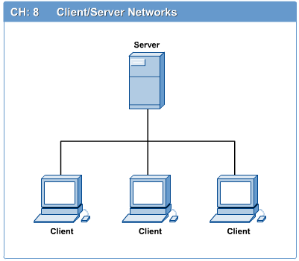
Client/Server
In a client/server network arrangement, network services are located in a dedicated computer whose only function is to respond to the requests of clients.
The server contains the file, print, application, security, and other services in a central computer that is continuously available to respond to client requests.
In a client/server LAN, some of the application processing and data manipulation are reserved for the server while other processing takes place on the client.

Slide 68
Hostname A unique identification that specifies a particular computer on the Internet
For example
matisse.csc.villanova.edu
condor.develocorp.com

Slide 69
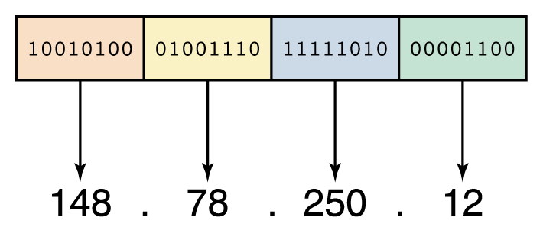
IP Addressing
An IP ADDRESS is a unique identifying string expressed as four decimal numbers ranging from 0 to 255, separated by periods, with each of the four numbers representing 8 bits of the address for a total length of 32 bits for the whole address.
An IP address can be split into network address, which specifies a specific network host number, which specifies a particular machine in that network.

Slide 70
Class A Networks
Class A addresses can range from 0 to 127 in the first octet meaning 128 possible networks.
You can have up to 126 possible networks. 2 are invalid (network name and broadcast)
Each network can have up to 16,777,214 hosts or nodes.
The default subnet mask for Class A networks is 255.0.0.0.
From 10.0.0.0 to 10.255.255.255 are private class B addresses.

Slide 71
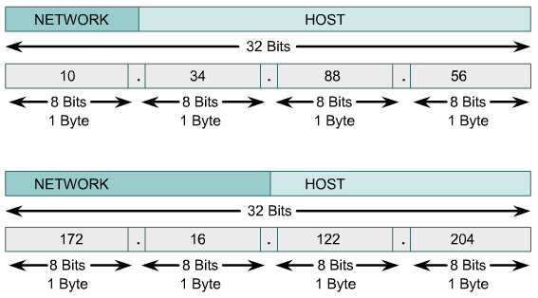

Slide 72
Class B Networks
Ranges from 128 to 191.
Can have up to 16,382 possible networks.
Each of which can have up to 65,534 nodes.
The default subnet mask is 255.255.0.0.
The address 127.0.0.0 is left for loopback.
It's used for the special purpose known as loopback
Loopback is a diagnostic test used to verify that a node can send and receive IP data transmissions.
From 172.16.0.0 to 172.31.255.255 are private class B addresses.

Slide 73
Class C Networks.
First ­octet ranges from 192 to 223.
It's possible to have up to 2,097,150 networks
Each network can have up to 254 nodes.
The default subnet mask is 255.255.255.0.
E.g: From 192.168.0.0 to 192.168.255.255

Slide 74
Class D and Class E Networks
Class D is used for IP multicasts.
Address ranges is from 224.0.0.0 to 239.255.255.255
Class E is reserved for future use, or research and development purposes.
Address ranges is from 240.0.0.0 to 254.255.255.254

Slide 75
Netmask
Determines which portion of the IP address is the network address and the host or node address
For example:
IP address: 12.128.1.2
Netmask: 255.0.0.0
Network address: 12.0.0.0

Slide 76
Gateway Address
A Gateway Address is the IP address through which a particular network, or host on a network be may be reached.
Broadcast Address
IP address which allows network data to be sent simultaneously to all hosts on a given sub-network

Slide 77
A hostname consists of the computer name followed by the domain name
E.g. compeng.coeknust.edu is the domain name
A domain name is separated into two or more sections that specify the organization, and possibly a subset of an organization, of which the computer is a part.
Two organizations can have a computer named the same thing because the domain name makes it clear which one is being referred to.

Slide 78
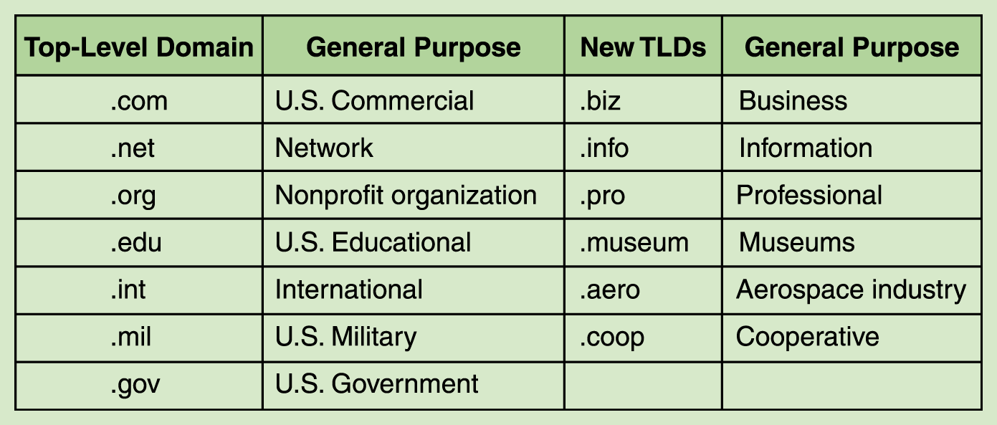
The very last section of the domain is called its top-level domain (TLD) name.

Slide 79
Domain Name Service (DNS) Server
Is a type of network server that helps to point domain names or the hostname to their associated IP address.
The domain name system (DNS) is chiefly used to translate hostnames into numeric IP addresses.
DNS is an example of a distributed database.
If that server can resolve the hostname, it does so
If not, that server asks another domain name server

Slide 80
Assigning IP addresses.
Every device on an IP network requires an IP address. IP addresses can be assigned manually (static) or by using DHCP (Domain host configuration protocol).
Manual assignments are time consuming and error prone.
Automatic assignments through DHCP are convenient and a big time saver for network technicians.

Slide 81
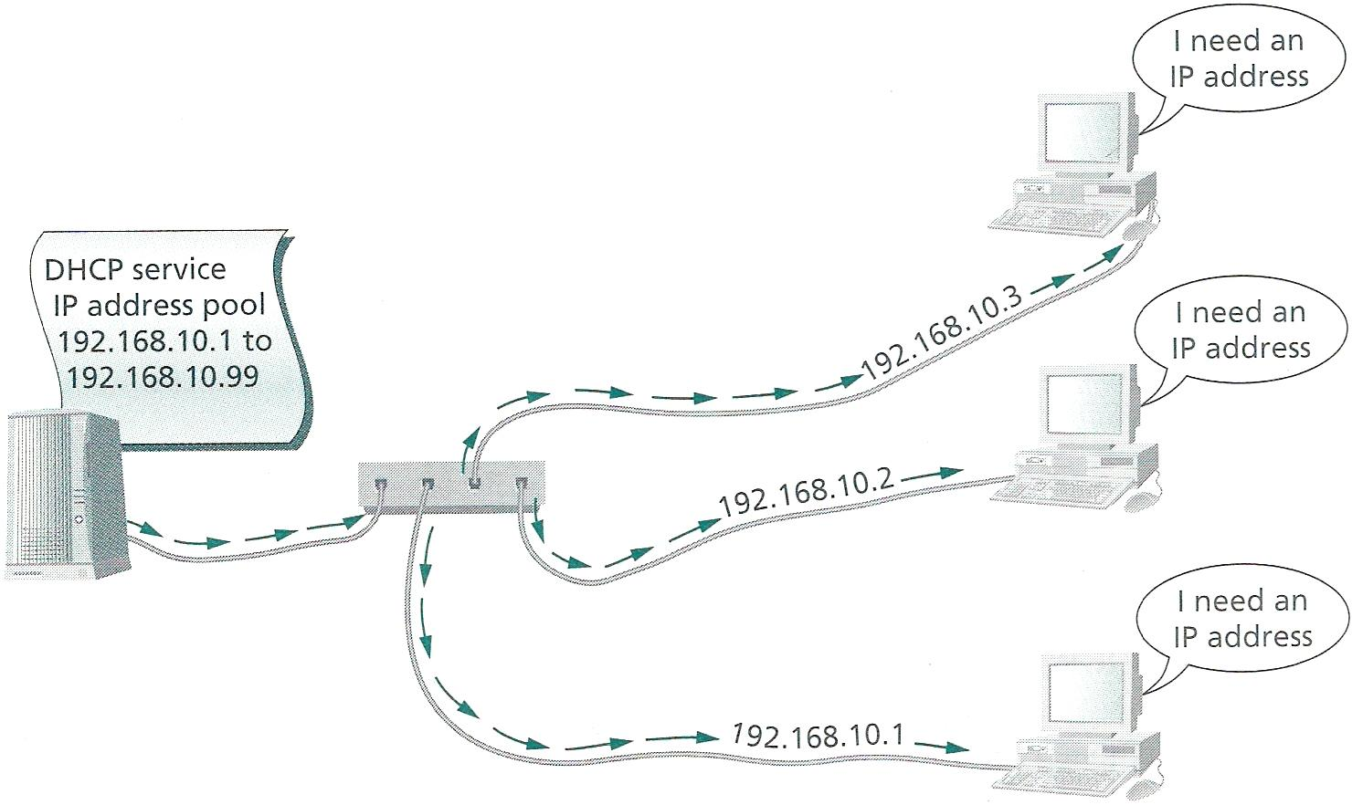

Slide 82
Networking Operating Systems (NOS)
A network operating system is the software that interfaces between server hardware and the network to which the server is attached.
Provides users with controlled access to shared services on a network.
NOS that run on servers include: Novell Netware, Microsoft Windows(NT, 2000 server, 2003 server, 2008 server), Linux, Unix, Sun Solaris

Slide 83
QUESTIONS???

